Slide 1
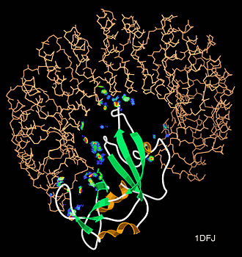
Al-Farabi Kazakh National University
Higher School of Medicine
Department of Fundamental Medicine
Interactomics (the research of protein-protein interactions)
Lecturer and creator: PhD Pinsky Ilya Vladimirovich
Notes:
Weaver, PART I

Slide 2
LEARNING OUTCOMES
As a result of the lesson you will be able to:
1. Give the definition to the terms “interactome” and “interactomics”.
2. Characterize the experimental methods of interactomics: yeast two-hybrid system (Y2H-assays), phage display, solid phase affinity chromatography, molecular fishing on the chip of optical biosensor, mass-spectrometry and microscopic methods. Give the specific examples.
3. Analyze and compare the bioinformatical methods of interactomics: phylogenetic trees, interaction networks and etc.

Slide 3
Definitions
Interactomics is a discipline at the intersection of bioinformatics and biology that deals with studying both the interactions and the consequences of those interactions between and among proteins, and other molecules within a cell.
In molecular biology, an interactome is the whole set of molecular interactions in a particular cell. The term specifically refers to physical interactions among molecules (such as those among proteins, also known as protein–protein interactions, PPIs; or between small molecules and proteins[1]) but can also describe sets of indirect interactions among genes (genetic interactions). The interactomes based on PPIs should be associated to the proteome of the corresponding species in order to provide a global view ("omic") of all the possible molecular interactions that a protein can present.[2]
The word "interactome" was originally coined in 1999 by a group of French scientists headed by Bernard Jacq.[3] Mathematically, interactomes are generally displayed as graphs. Though interactomes may be described as biological networks, they should not be confused with other networks such as neural networks or food webs.

Slide 4
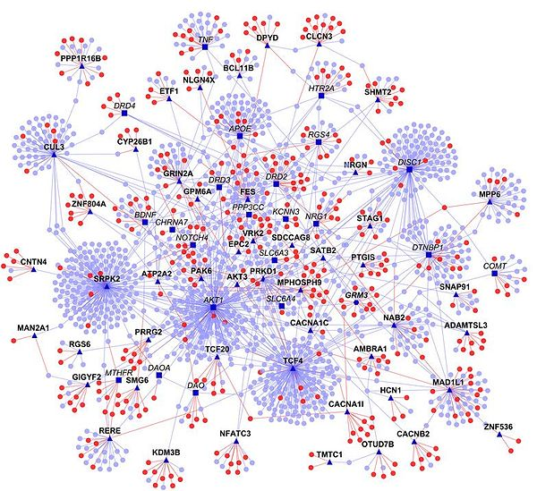
Ganapathiraju MK, Thahir M, Handen A, Sarkar SN, Sweet RA, Nimgaonkar VL, Loscher CE, Bauer EM, Chaparala S (April 2016). "Schizophrenia interactome with 504 novel protein–protein interactions". NPJ Schizophrenia. 2: 16012. doi:10.1038/npjschz.2016.12. PMC 4898894. PMID 27336055.

Slide 5
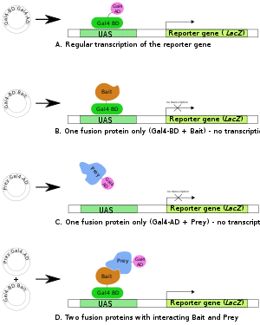
Overview of two-hybrid assay, checking for interactions between two proteins, called here Bait and Prey.
A. The Gal4 transcription factor gene produces a two-domain protein (BD and AD) essential for transcription of the reporter gene (LacZ).
B,C. Two fusion proteins are prepared: Gal4BD+Bait and Gal4AD+Prey. Neither of them are usually sufficient to initiate transcription (of the reporter gene) alone.
D. When both fusion proteins are produced and the Bait part of the first fusion protein interacts with the Prey part of the second, transcription of the reporter gene occurs.
https://en.wikipedia.org/wiki/Two-hybrid_screening#/media/File:Two_hybrid_assay.svg

Slide 6
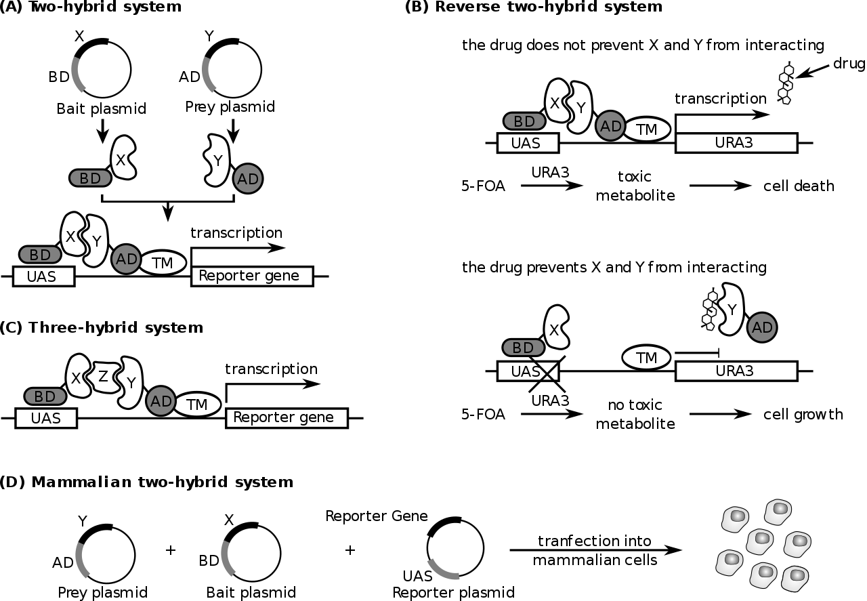
https://en.wikipedia.org/wiki/Protein%E2%80%93protein_interaction#/media/File:Principles_of_yeast_and_mammalian_two-hybrid_systems.svg

Slide 7
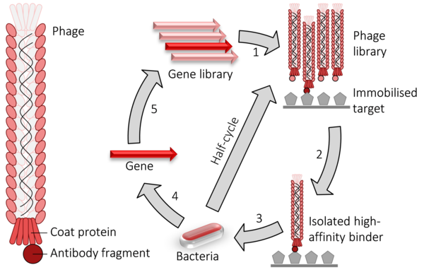
Phage display cycle. 1) fusion proteins for a viral coat protein + the gene to be evolved (typically an antibody fragment) are expressed in bacteriophage. 2) the library of phage are washed over an immobilised target. 3) the remaining high-affinity binders are used to infect bacteria. 4) the genes encoding the high-affinity binders are isolated. 5) those genes may have random mutations introduced and used to perform another round of evolution. The selection and amplification steps can be performed multiple times at greater stringency to isolate higher-affinity binders.
https://en.wikipedia.org/wiki/Phage_display#/media/File:Phage_display.png

Slide 8
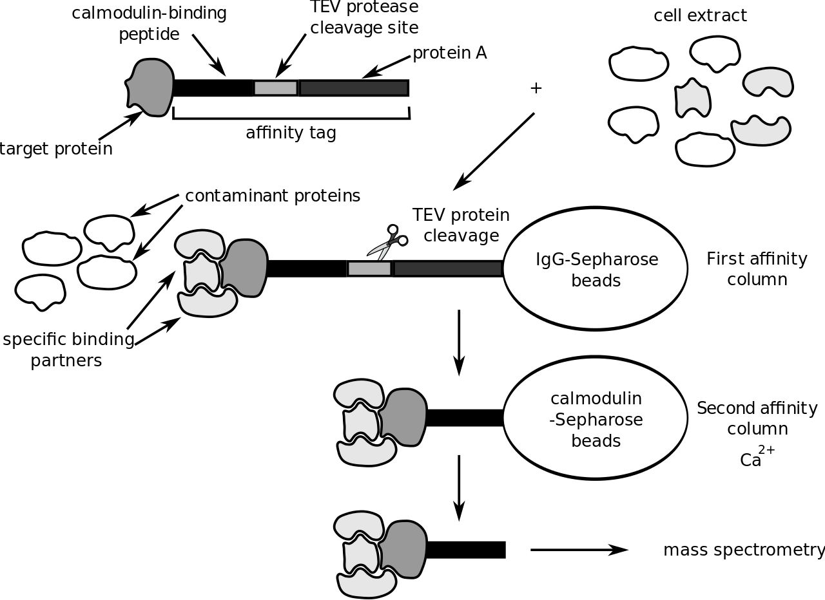
Principle of tandem affinity purification.
Philippe Hupé - Emmanuel Barillot, Laurence Calzone, Philippe Hupé, Jean-Philippe Vert, Andrei Zinovyev, Computational Systems Biology of Cancer Chapman & Hall/CRC Mathematical & Computational Biology , 2012

Slide 9
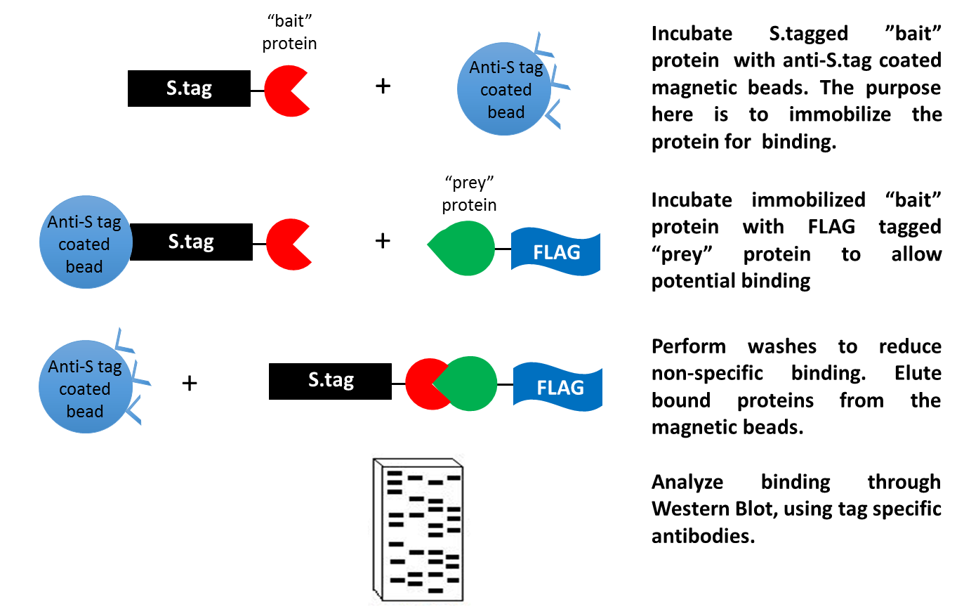
https://en.wikipedia.org/wiki/Immunoprecipitation#/media/File:Pull_down_assay_using_tagged_proteins.tif

Slide 10
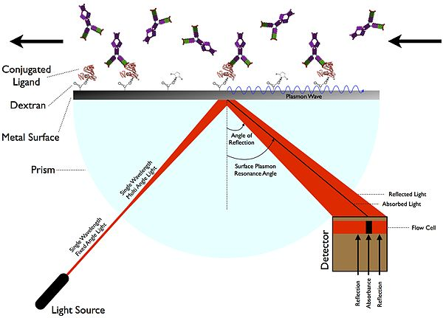
Surface plasmon resonance (SPR).
SariSabban - Sabban, Sari (2011) Development of an in vitro model system for studying the interaction of Equus caballus IgE with its high- affinity FcεRI receptor (PhD thesis), The University of Sheffield

Slide 11
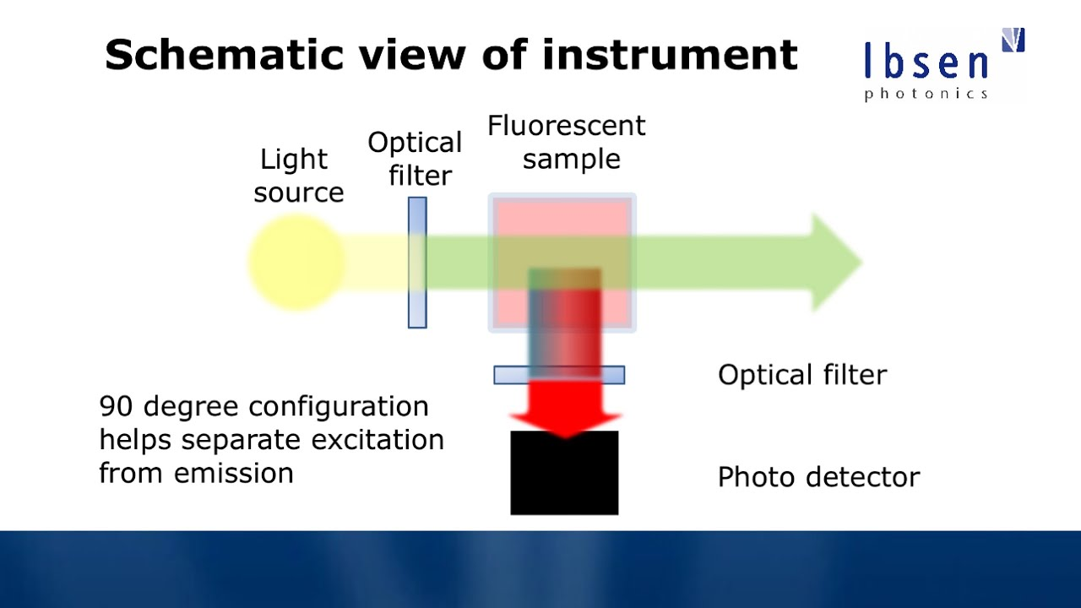
Fluorescence Spectroscopy
youtube.com

Slide 12
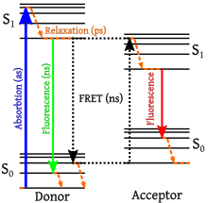
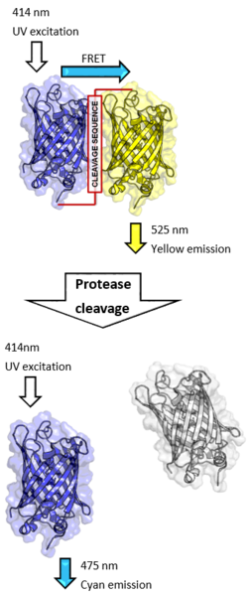
FRET (fluorescence resonance energy transfer).
If the linker is intact, excitation at the absorbance wavelength of CFP (414nm) causes emission by YFP (525nm) due to FRET. If the linker is cleaved by a protease, FRET is abolished and emission is at the CFP wavelength (475nm).
https://en.wikipedia.org/wiki/F%C3%B6rster_resonance_energy_transfer#/media/File:Proteolytic_cleavage_of_a_Dual-GFP_fusion_FRET-pair.png

Slide 13
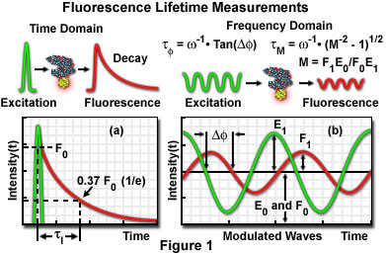
Fluorescence Lifetime Imaging (FLIM)
olympusconfocal.com

Slide 14
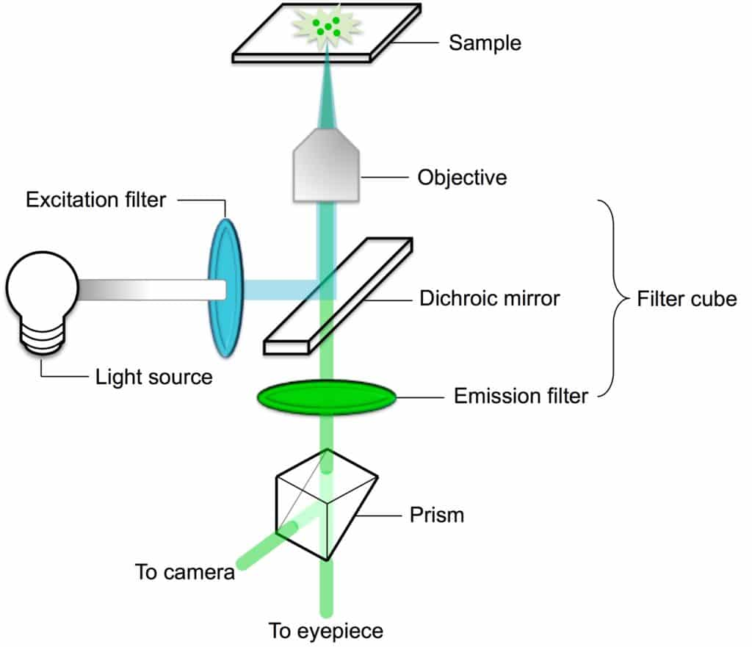
Fluorescence Microscopy
bitesizebio.com

Slide 15
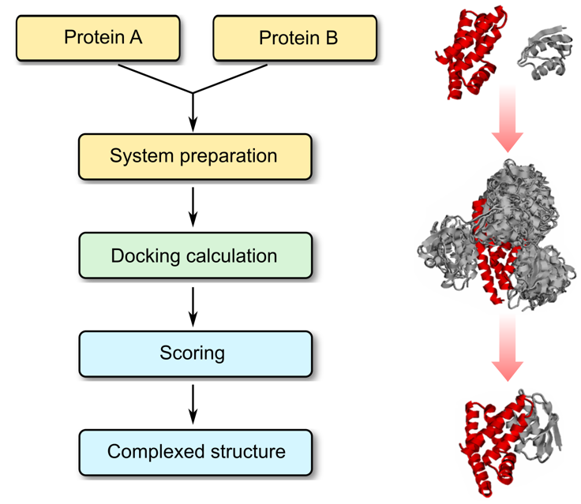
Protein–Protein Docking - Profacgen
profacgen.com

Slide 16
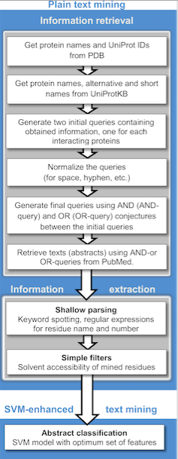
Varsha D. Badal, Petras J. Kundrotas , Ilya A. Vakser - Text Mining for Protein Docking

Slide 17
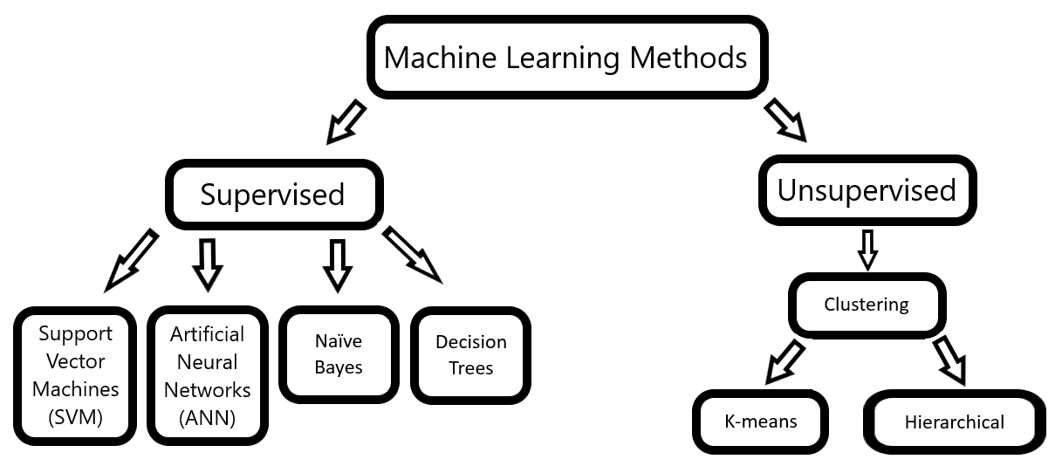
https://en.wikipedia.org/wiki/Protein%E2%80%93protein_interaction#/media/File:Sarkar&Saha_Figure1A.png

Slide 18
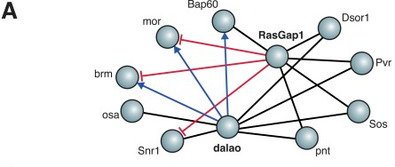
The protein-protein interactions are displayed in a signed network that describes what type of interactions that are taking place.
Bernd Fischer, Thomas Sandmann, Thomas Horn, Maximilian Billmann, Varun Chaudhary, Wolfgang Huber, Michael Boutros - A map of directional genetic interactions in a metazoan cell eLife Sciences DOI 10.7554/eLife.05464 http://elifesciences.org/content/4/e05464.abstract

Slide 19
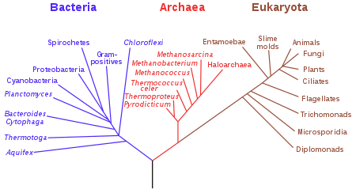
Phylogenetic tree
en.wikipedia.org

Slide 20
References
Wang L, Eftekhari P, Schachner D, Ignatova ID, Palme V, Schilcher N, Ladurner A, Heiss EH, Stangl H, Dirsch VM, Atanasov AG. Novel interactomics approach identifies ABCA1 as direct target of evodiamine, which increases macrophage cholesterol efflux. Sci Rep. 2018 Jul 23;8(1):11061. doi: 10.1038/s41598-018-29281-1.
Alonso-López D, Gutiérrez MA, Lopes KP, Prieto C, Santamaria R, De Las Rivas J (2016). "APID interactomes: providing proteome-based interactomes with controlled quality for multiple species and derived networks". Nucleic Acids Res. 44 (W529–35): W529–35. doi:10.1093/nar/gkw363. PMC 4987915. PMID 27131791.
Sanchez C; Lachaize C; Janody F; et al. (January 1999). "Grasping at molecular interactions and genetic networks in Drosophila melanogaster using FlyNets, an Internet database". Nucleic Acids Res. 27 (1): 89–94. doi:10.1093/nar/27.1.89. PMC 148104. PMID 9847149.

